Slide 1
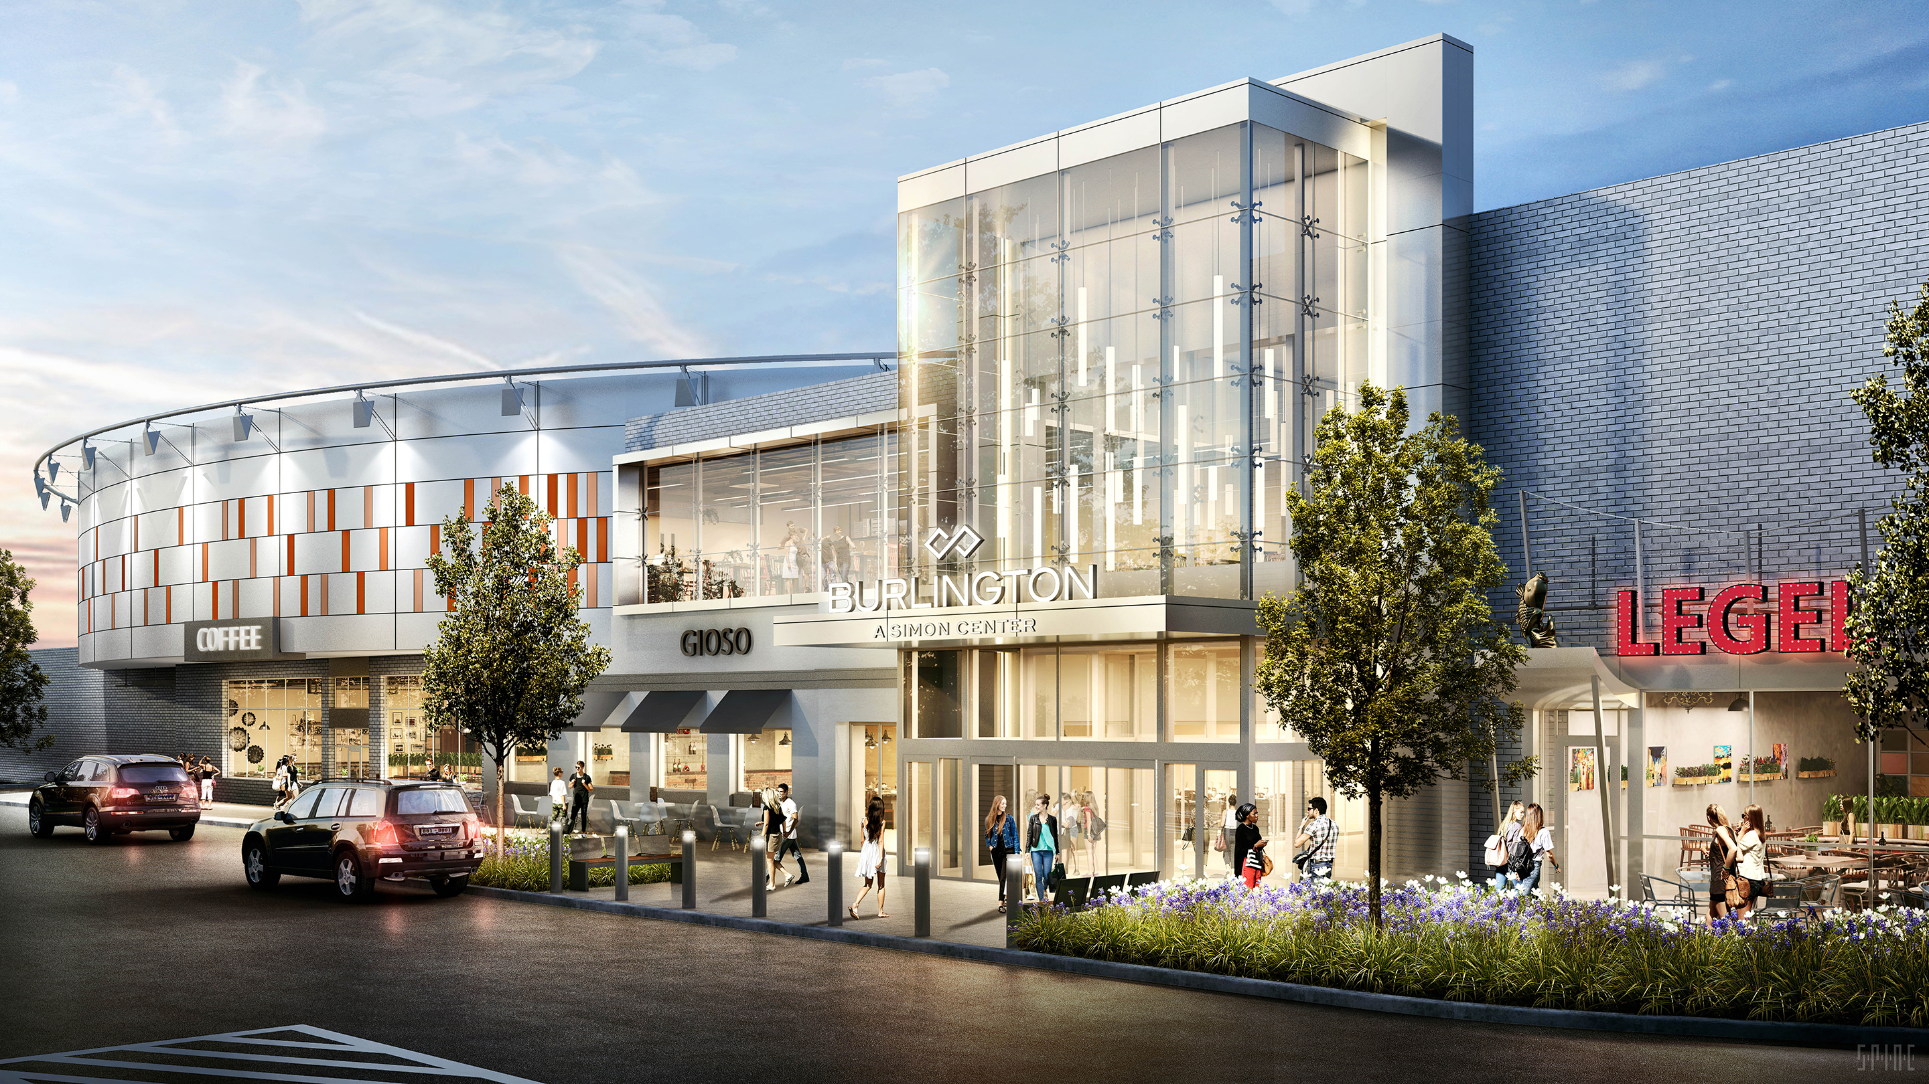
Mall Team E: Abraham Freeman, Jonathan Ortiz

Slide 2
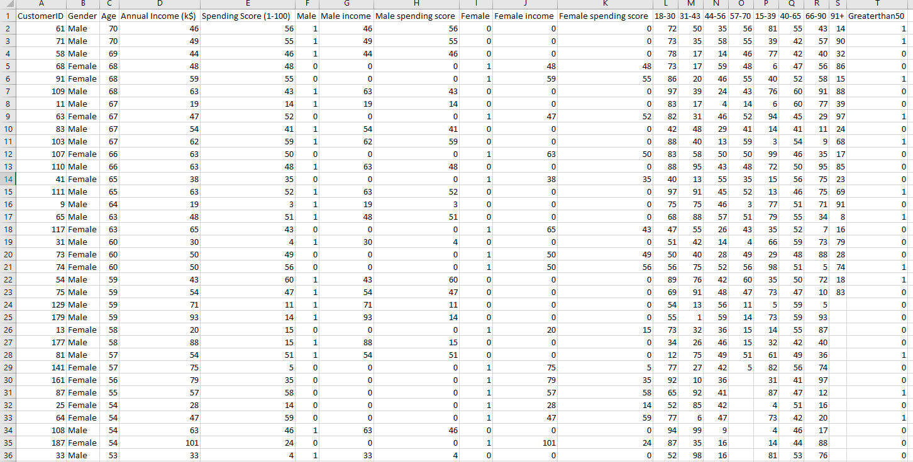
The Data and Modifications
For Gender in the K-Means data set, Male was changed to a 1 and Female to 0
Binned Age Groups For Histogram & Income For further analysis on Data Questions 2 &3
Separated income and spending score by gender analysis

Slide 3
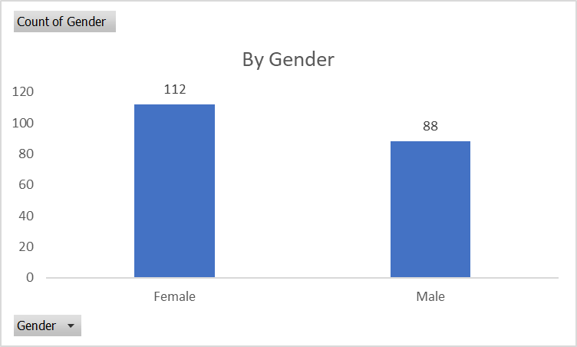
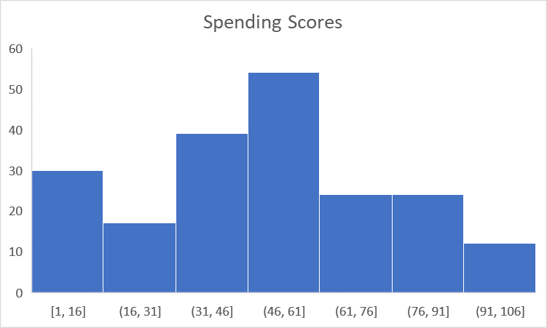
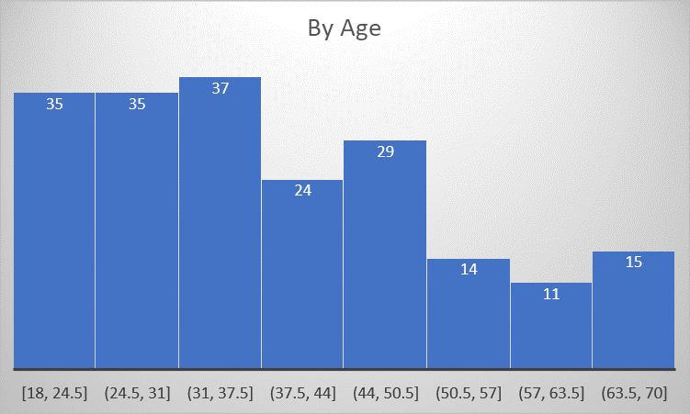
Data Highlights
Our data tends to have a younger crowd of mostly female, but the spending scores seem to follow a normal distribution

Slide 4
Data Questions:
What gender Is more likely to have a higher spending score?
What age bracket has the highest spending score?
What income bracket has the highest spending score?
Which attribute has the highest correlation with higher spending scores?
Which market segment should we focus our marketing on to get the highest spending scores?

Slide 5
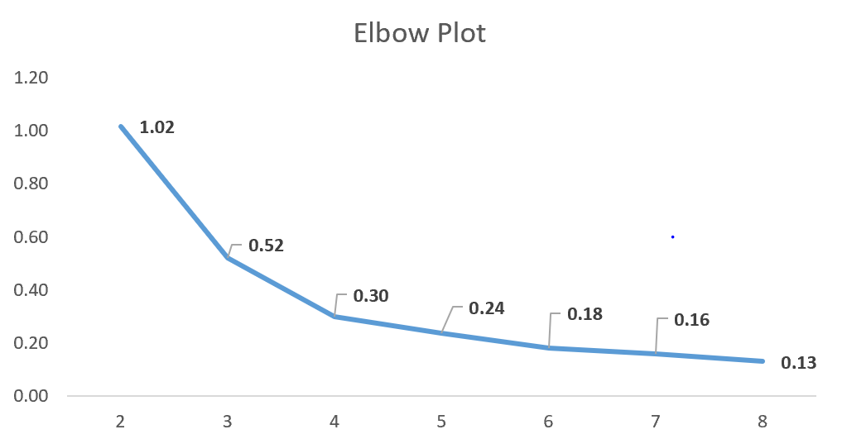
Elbow Plot
Ran K-Means Cluster
Ratio “Between-Classes” to “Within-Classes” levels off at Segment 5.
Chose to go with 4 clusters

Slide 6
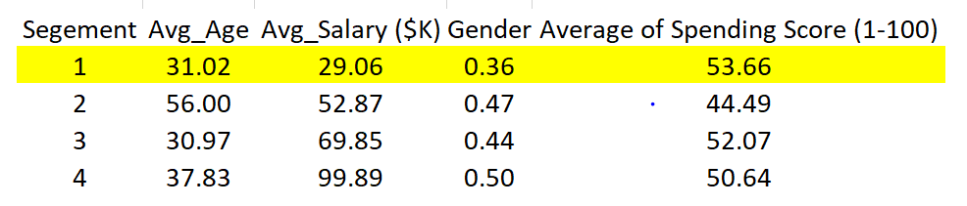
Segment 1
Is the 2nd youngest by .05 years and leans the most female. It also contains the lowest average salary by a significant margin yet has the highest spending score

Slide 7
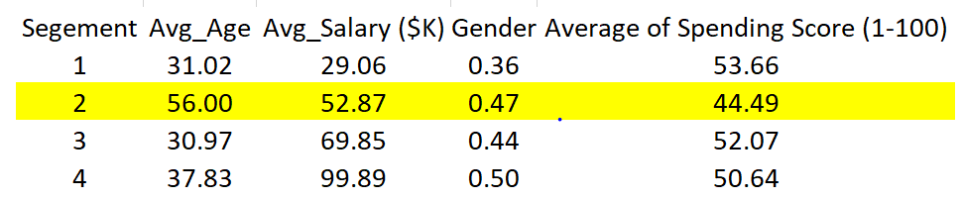
Segment 2
Is by far the oldest group and has lowest spending score. Also leans second most male

Slide 8
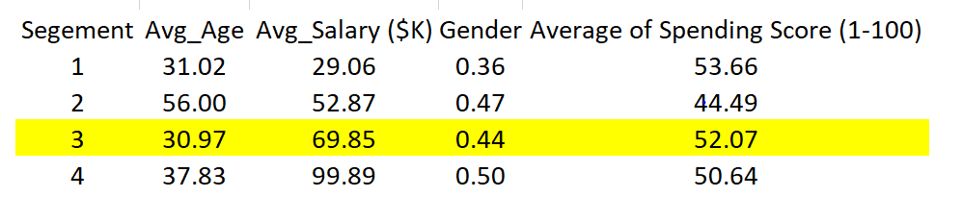
Segment 3
Segment 3 is youngest with second highest score and second highest income

Slide 9
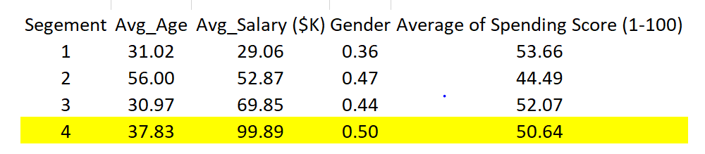
Segment 4
Leans the most male, has significantly highest salary and 2nd lowest score

Slide 10
K-Means Effectiveness
Identifiability – The two youngest groups lean female and have the highest spending score
Sustainability – 100% of the data represents current Mall customers.
Accessibility – Can target customers through in store promotions, local adds and events
Actionability – Segments are consistent with the goals of the mall; Sell merchandise!

Slide 11
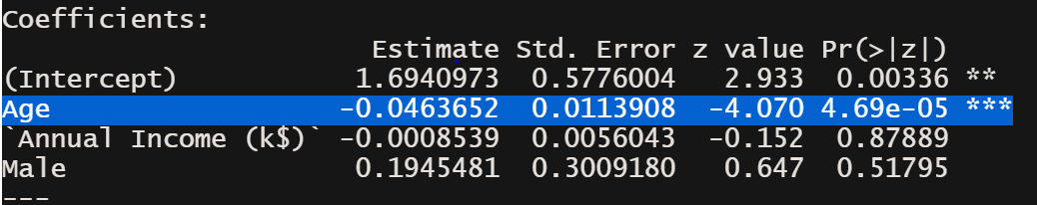
Linear Regression
Age is the only statistically significant variable
Our R-squared is .097%
Mean Absolute error is 20.37 (very right skewed)
Reasoning:
Older people generally make more money
Older people tend to be more fiscally responsible.

Slide 12
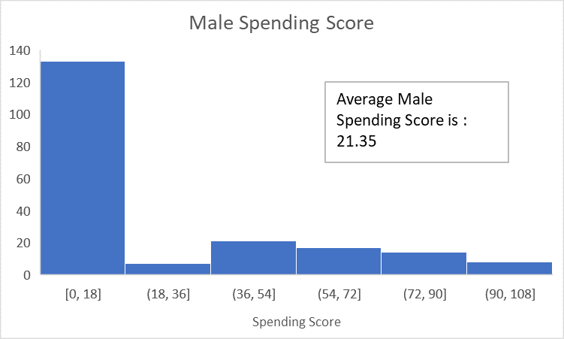
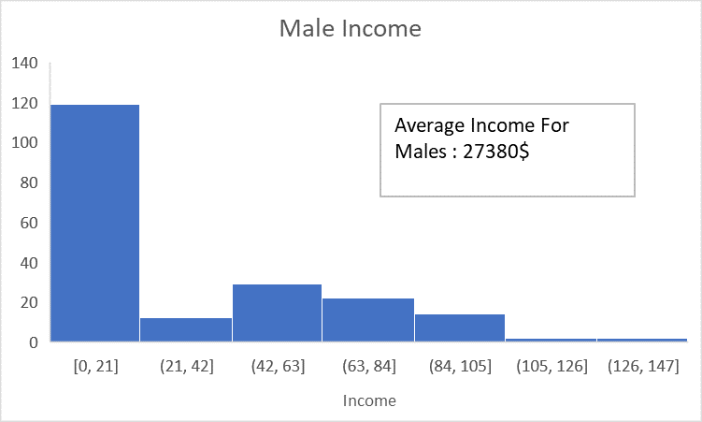
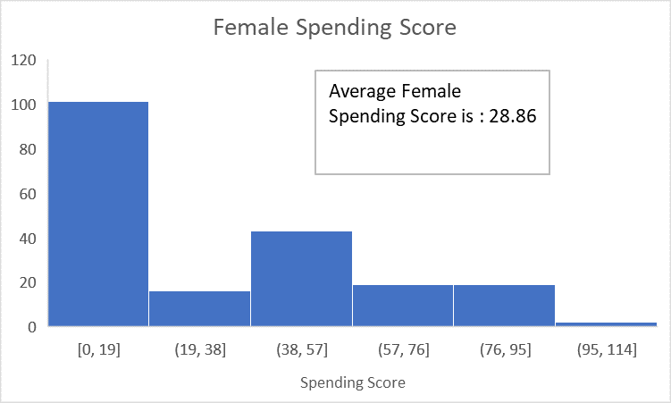
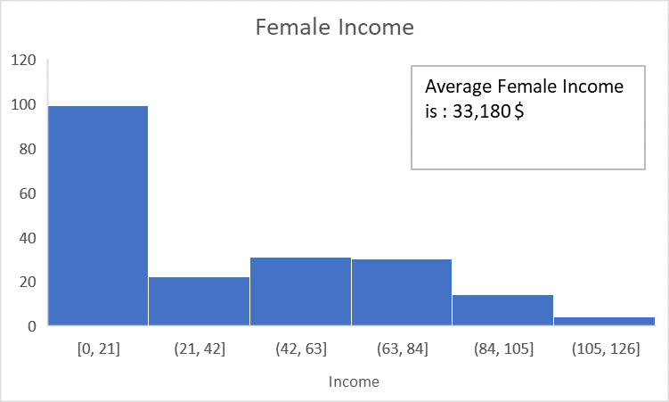
Data Question 1: What gender Is more likely to have a higher spending score?
Females are more likely to have a higher spending score, but they also make more money.
These Findings are supported by Segments 1 & 3 in the K Means Cluster

Slide 13
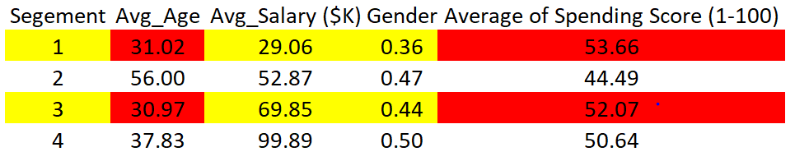
Data Question Answers
What age bracket has the highest spending score?
By splitting the data by age brackets of 12 years. The highest spenders by age is 18 – 30 years old with an average score of 61 and 31 - 43 with a close second at 54

Slide 14
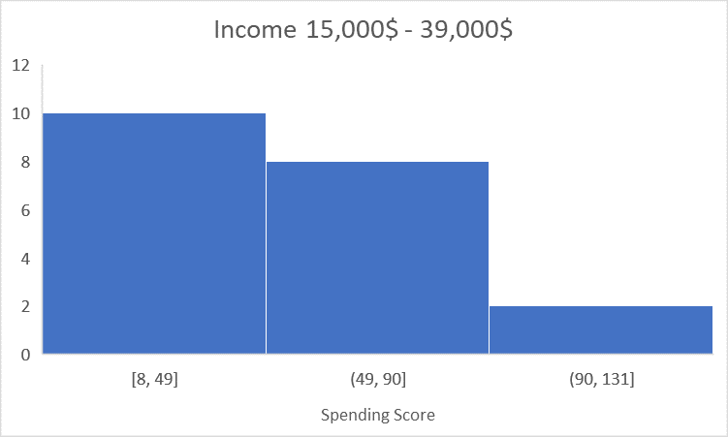
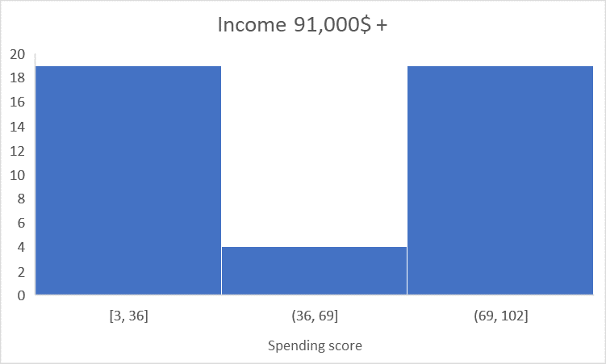
Data Question Answers
What income bracket has the highest spending score?

Slide 15
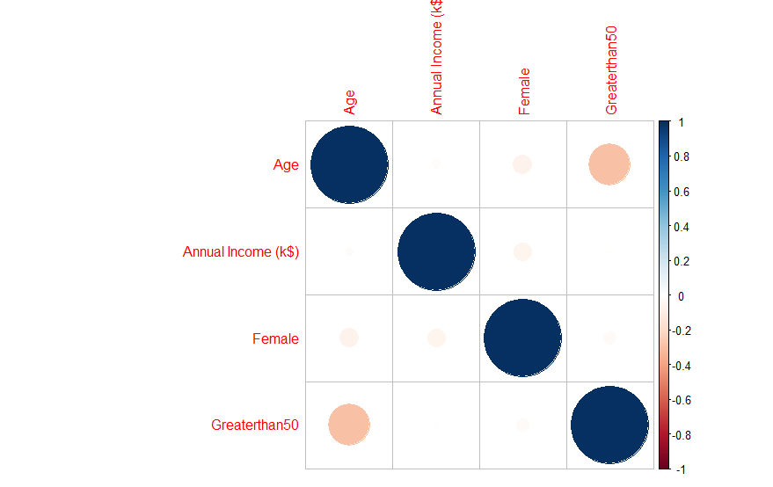
Data Question Answers
Which attribute has the highest correlation with higher spending scores?
Age has the highest correlation to
Spending Score. They are inversely
proportional. As age goes down,
Spending goes up.
Gender, combined with age, factors into
Spending score. Younger females tend to
spend more

Slide 16
Where to Focus?
Market to young woman as they make up a significant portion of mall business. Promote stores that appeal to this demographic, eg, Lulu Lemon, Sephora and Anthropologie.
The highest income group was the most male of the four but had the second lowest spending score. This could be potential for growth. Bring in stores that attract this demographic, eg, Golf Store, Rolex or a high end car dealership.
There is a significant drop off in spending for customers in their late fifties. This could be do to retiriees on a fixed income.

